Slide 1
ASPC Board members
Board of Directors members from Hong Kong 2021 to Paris 2023:
President: Tapio Korjus (FIN) - tapio.korjus@sportperformancecentres.org
Secretary General: Josep Escoda (ESP) - josep.escoda@sportperformancecentres.org
Executive Vicepresident: Debbie Low (CAN) - debbie.low@sportperformancecentres.org
Treasurer: Steve Lawrence (AUS) - steve.lawrence@sportperformancecentres.org
Vice President for America: Ken Bagnell (CAN) - ken.bagnell@sportperformancecentres.org
Vice President for Europe: Harry Baehr (GER) - harry.baehr@sportperformancecentres.org
Vice President for Africa: Dr Kevin Subban (SAF) - kevin.subban@sportperformancecentres.org
Vice President for Asia: Takeshi Kukidome (JPN) - takeshi.kukidome@sportperfomancecentres.org
Vice President for Oceania: Anne Marie Harrison (AUS) - annemarie.harrisson@sportperformancecentres.org
Past President: Dale Henwood (CAN) - dale.henwood@sportperformancecentres.org
Previous Forum Host: Brendon Goodenough (SAF) - brendon@sportperformancecentres.org
Next Forum Host: Raymond So (HKG) - raymond.so@sportperformancecentres.org
Next Forum Host: Babak.AMIR-TAHMASSEB (FRA) - babak.amir-tahmasseb@sportperformancecentres.org
Host Secretariat: Silvia Matesanz (ESP) - silvia.matesanz@sportperformancecentres.org
Former Presidents: Mike English (USA) Jukka Lahtinen (FIN) - In Memoriam

Slide 2
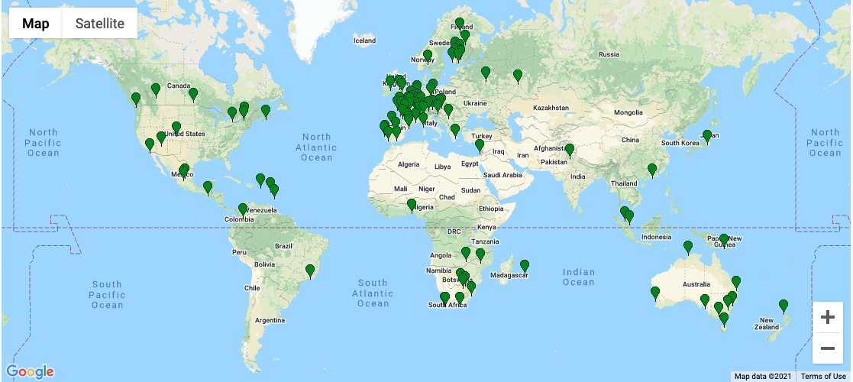
ASPC Members

Slide 3
ASPC Members

Slide 4
ASPC Members

Slide 5
ASPC Members

